Slide 1
Chapter 21: Troubleshooting Wireless Connectivity
Instructor Materials
CCNP Enterprise: Core Networking

Slide 2
Chapter 21 Content
This chapter covers the following content:
Troubleshooting Client Connectivity from the WLC - This section discusses how to use a wireless LAN controller as a troubleshooting tool to diagnose problems with wireless clients.
Troubleshooting Connectivity Problems at the AP - This section discusses how to diagnose problems between a wireless LAN controller and an AP that might affect wireless client connectivity.

Slide 3
Troubleshooting Client Connectivity from WLC
Most of your time managing and monitoring a wireless network will be spent in the wireless LAN controller GUI.
You can access a wealth of troubleshooting information from the controller, if you know the client’s MAC address.

Slide 4
Troubleshooting Client Connectivity from WLC Troubleshooting Client Connectivity from WLC
When one or more network users report that they are having problems, your first course of action should be to gather more information, ask questions, and try to notice patterns or similarities in the answers you receive.
Information from the user such as, “I cannot connect” or “The Wi-Fi is down” might mean that the user’s device cannot associate, cannot get an IP address, or cannot authenticate.
If you get reports from many people in the same area, perhaps an AP is misconfigured or malfunctioning.
Reports from many areas or from a single service set identifier (SSID) may indicate problems with a controller configuration.

Slide 5
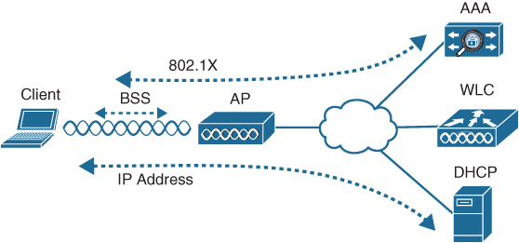
Troubleshooting Client Connectivity from WLC Conditions for a Successful Wireless Association
If you receive a report of only one wireless user having problems, it might not make sense to spend time troubleshooting a controller, where many users are supported. Instead, you should focus on that one user’s client device and its interaction with an AP.
Figure 21-1 illustrates the following conditions that must be met for a successful association:
The client is within RF range of an AP and asks to associate.
The client authenticates.
The client requests and receives an IP address.
Figure 21-1 Conditions for a Successful Wireless Association

Slide 6
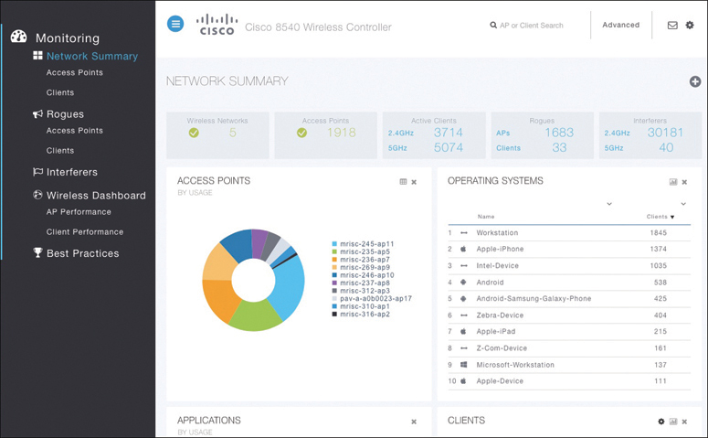
Troubleshooting Client Connectivity from WLC Cisco WLC GUI
Cisco WLCs have two main GUI presentations, one for monitoring and one for more advanced configuration and monitoring.
When you open a browser to the WLC management address, you see the default screen that is shown in Figure 21-2.
The default screen displays network summary dashboard information on the right portion and monitoring tools in the list on the left.
Figure 21-2 The Initial Default WLC Display

Slide 7
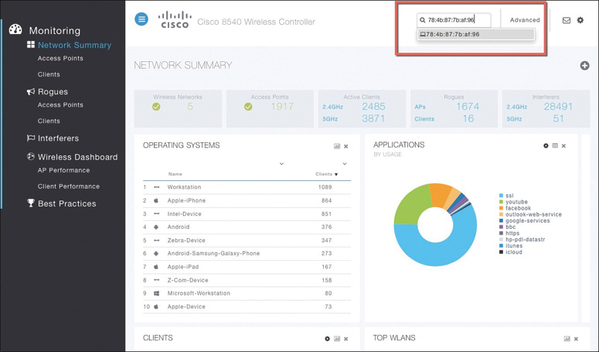
Troubleshooting Client Connectivity from WLC Searching for a Client in the WLC GUI
If you know a specific wireless client’s MAC address, you can enter it into the search bar at the top right of the screen.
For example, in Figure 21-3, 78:4b:87:7b:af:96 is the target of the search. Because that MAC address is known to the controller, a match is shown with a client icon below the search bar.
Figure 21-3 Searching for a Client in the WLC GUI

Slide 8
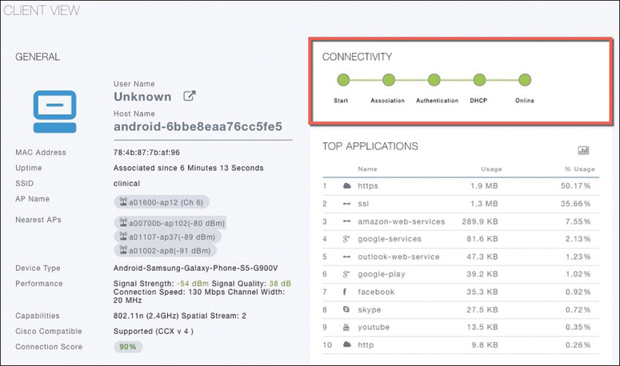
Troubleshooting Client Connectivity from WLC Client Search Results
The resulting details about the client are displayed in the Client View screen, shown in Figure 21-4.
From this output, you can see many details about the client device listed in the left portion of the screen, and you can see connectivity and application information displayed on the right.
Figure 21-4 Client Search Results

Slide 9
Troubleshooting Client Connectivity from WLC Checking the Client’s Connection Status
Before a controller will permit a client to fully associate with a basic service set (BSS), the client must progress through a sequence of states. Each state refers to a policy that the client must meet before moving on to the next state:
Start - Client activity has just begun.
Association - The client has requested 802.11 authentication and association with an AP.
Authentication - The client must pass a Layer 2 Pre-Shared Key (PSK) or 802.1x authentication policy.
DHCP - The WLC is waiting to learn the client’s IP address from a Dynamic Host Configuration Protocol (DHCP) server.
Online - The client has passed Layer 2 and Layer 3 policies, successfully associated, and can pass traffic.

Slide 10
Troubleshooting Client Connectivity from WLC Checking the Client’s Association and Signal Status
Information such as the wireless client’s username (if known), hostname, wireless MAC address, wireless connection uptime, and the SSID used can be viewed in the left portion of the Client View screen.
In Figure 21-4, the username is not known because the client does not authenticate itself with a username.
Figure 21-4 Client Search Results

Slide 11
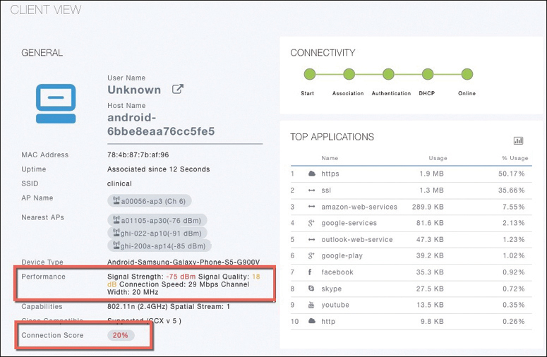
Troubleshooting Client Connectivity from WLC WLC Information About a Poorly Performing Client
In Figure 21-5 the AP is receiving the client’s signal strength at −76 dBm and the SNR at 18 dB (both rather low values), causing the current data rate to fall to 29 Mbps. A quick look at the Connection Score value reveals a low 20%.
It is safe to assume that the client has moved too far away from the AP where it is associated, causing the signal strength to become too low to support faster performance.
Figure 21-5 WLC Information About a Poorly Performing Client

Slide 12
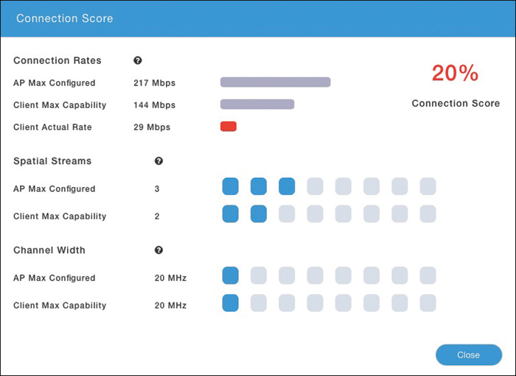
Troubleshooting Client Connectivity from WLC WLC Information About a Poorly Performing Client
Clicking on the Connection Score value displays further details in a popup window, as shown in Figure 21-6.
The 20% value is the result of the client’s current data rate (29 Mbps) divided by the lower of the AP or client maximum data rate (144 Mbps).
The Client Actual Rate and Connection Score values are indicators of current performance, and the other graphs show what is possible on the AP and the client.
Figure 21-6 Displaying Detailed Client Performance Information

Slide 13
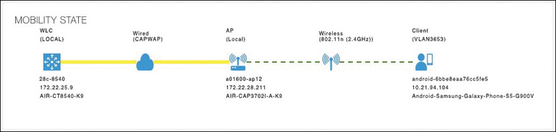
Troubleshooting Client Connectivity from WLC Checking the Client’s Mobility State
The WLC Client Search information includes a handy end-to-end graphical representation of a client’s wireless connection.
When you scroll down below the General and Connectivity sections, you see a topology diagram like the one shown in Figure 21-7.
The WLC’s name, management IP address, and model are displayed. Following the connection toward the right, you can see the AP name, IP address, and model where the client is associated. Moving further to the right, you can see that the client is associated to the AP. The client device is displayed with identifying information such as the device name, device type, VLAN number, and IP address.
Figure 21-7 Displaying the Client Mobility State

Slide 14
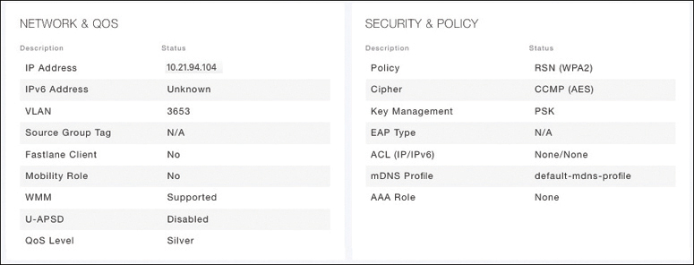
Troubleshooting Client Connectivity from WLC Checking the Client’s Wireless Policies
By scrolling further down in the Client Search information, you can verify information about network, QoS, security, and other policies that affect the client, as shown in Figure 21-8.
You can quickly learn the client’s IP address, VLAN number, QoS policy level used by the WLAN, security policy (WPA2), encryption cipher (CCMP AES), and authentication type (PSK with no EAP).
Figure 21-8 Displaying the Wireless Policies Used by a Client

Slide 15
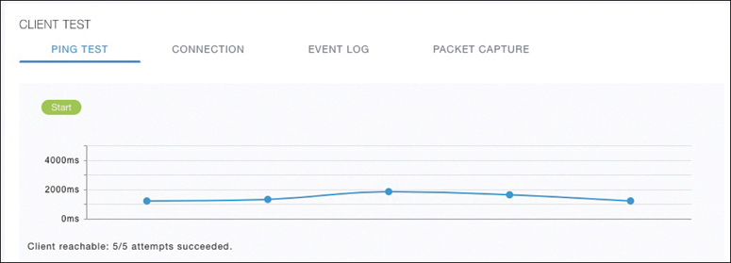
Troubleshooting Client Connectivity from WLC Testing a Wireless Client
When you search for a specific client, the information displayed is of a static nature because it is obtained as a snapshot at the time of the search. The client search will need to be refreshed to get up-to-date data. You can also obtain dynamic data by testing a client in real time.
By scrolling to the bottom of the client search information, you can see the Client Test section, which offers links to four client testing tools:
Ping Test: The WLC sends five ICMP echo packets to the client’s IP address and measures the response time, as shown in Figure 21-9.
Figure 21-9 Testing Ping Response
Times Between the WLC and Client

Slide 16
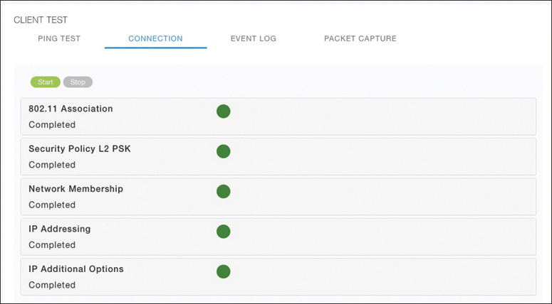
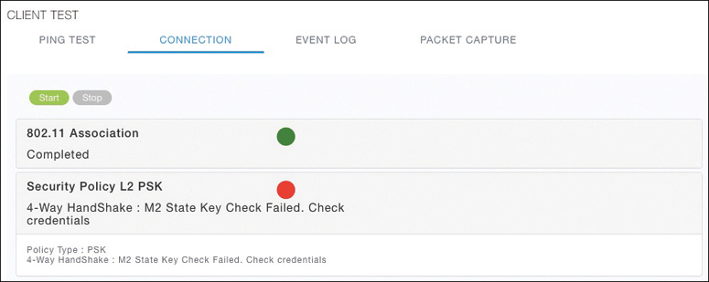
Troubleshooting Client Connectivity from WLC Testing a Wireless Client (Cont.)
Connection: The WLC debugs the client for up to three minutes and checks each policy step as the client attempts to join the wireless network.
Figure 21-10 shows a client that has successfully joined, and Figure 21-11 shows a client that failed Layer 2 authentication with a pre-shared key because its key did not match the key configured on the WLC.
Figure 21-10 Performing a Connection
Test on a Successful Wireless Client
Figure 21-11 Performing a Connection
Test on a Failed Wireless Client

Slide 17
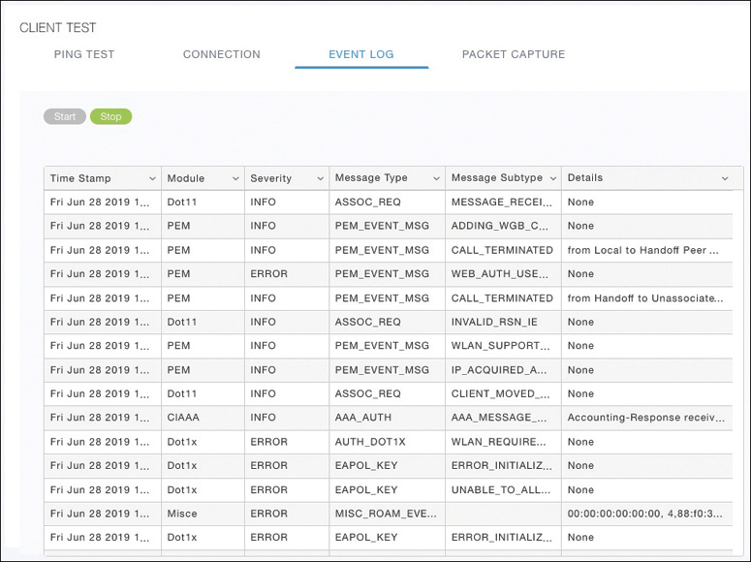
Troubleshooting Client Connectivity from WLC Testing a Wireless Client (Cont.)
Event Log: The WLC collects and displays a log of events as the client attempts to join the wireless network, as shown in Figure 21-12.
This information is very complex and detailed and is usually more suited for Cisco TAC engineers.
Figure 21-12 Collecting an Event Log of a Client Join Attempt

Slide 18
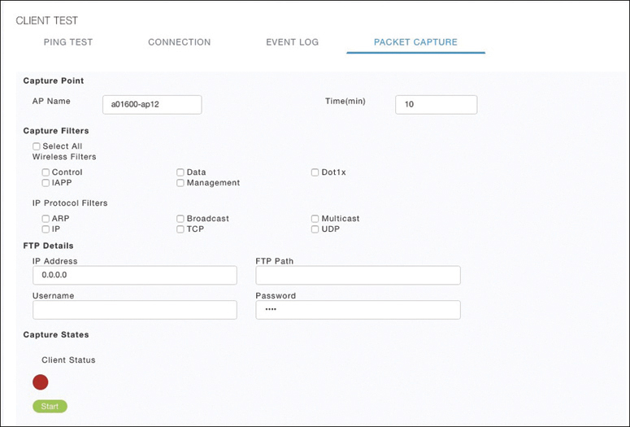
Troubleshooting Client Connectivity from WLC Testing a Wireless Client (Cont.)
Packet Capture: The WLC enables a wireless packet capture at the AP where the client attempts to join, as shown in Figure 21-13.
The captured data is saved to a specified FTP server, where it can be downloaded and analyzed using a packet analysis tool like Wireshark or LiveAction Omnipeek.
Figure 21-13 Performing a Packet Capture of a Wireless Client

Slide 19
Troubleshooting Connectivity at the AP
In cases where you get reports from multiple users who are all having problems in the same general area, you might need to focus your efforts on an AP.
The problem could be as simple as a defective radio, where no clients are receiving a signal. In that case, you might have to go onsite to confirm that the transmitter is not working correctly.

Slide 20
Troubleshooting Connectivity Problems at the AP Troubleshooting Connectivity Problems at the AP
The split-MAC architecture creates several different points where you can troubleshoot. Successfully operating the lightweight AP and providing a working BSS require the following:
The AP must have connectivity to its access layer switch.
The AP must have connectivity to its WLC, unless it is operating in FlexConnect mode.

Slide 21
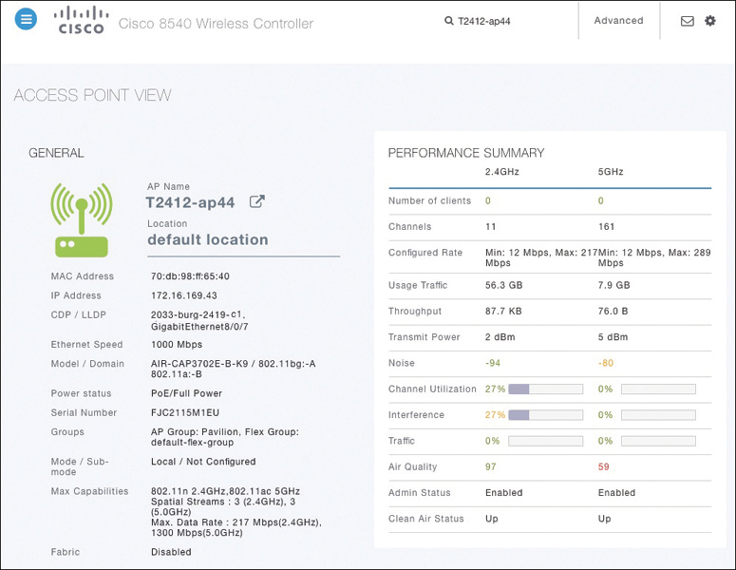
Troubleshooting Connectivity Problems at the AP Displaying Information About an AP
First, verify the connectivity between an AP and a controller.
The easiest approach is to simply look for the AP in the list of live APs that have joined the controller. If you know which controller the AP should join, open a management session to it. Enter the AP’s name in the search bar.
If the search reveals a live AP that is joined to the controller, information is displayed in the Access Point View screen, as shown in Figure 21-14.
Figure 21-14 Displaying Information About an AP

Slide 22
Troubleshooting Connectivity Problems at the AP Displaying Information About an AP (Cont.)
In Figure 21-14 the AP is named T2412-ap4, has an IP address and a valid CDP entry that shows the switch name and port number where it is connected. The AP has a live Ethernet connection with a switch and has working Power over Ethernet (PoE).
In the right portion of the Access Point View screen, you can verify parameters related to the AP’s wireless performance and RF conditions.
Figure 21-14 Displaying Information About an AP

Slide 23
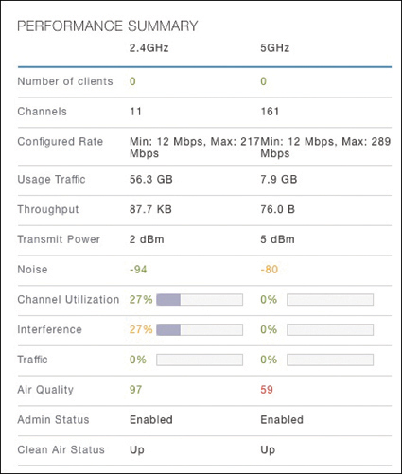
Troubleshooting Connectivity Problems at the AP Performance Summary Information
Another important indicator is the noise level on a channel. Ideally, the noise level should be as low as possible, usually around −90 or −100 dBm, so that 802.11 signals can be received intelligibly and accurately.
Figure 21-15 lists the 5 GHz channel 161 as having a high noise level of −80 dBm—something that is not normal or ideal.
Figure 21-15 Performance Summary Information

Slide 24
Troubleshooting Connectivity Problems at the AP Performance Summary Information (Cont.)
The channel information also shows an index of air quality. This is a measure of how competing and interfering devices affect the airtime quality or performance on a channel, presented as a number from 0 (worst) to 100 (best).
The AP shows the air quality of channel 11 as 97, which is very good. However, channel 161 is 59, which is of concern.
You can scroll further down in the Access Point View screen to see detailed information about the AP including a list of clients it is supporting, RF troubleshooting information, clean air assessments, and a tool to reboot the AP.
Figure 21-15 Performance Summary Information

Slide 25
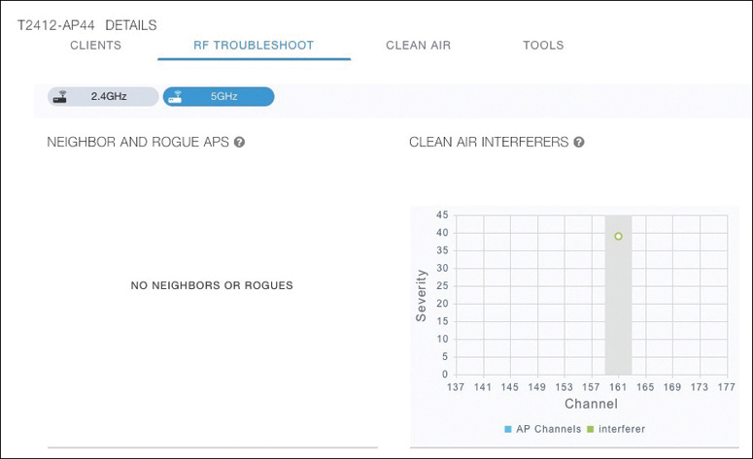
Troubleshooting Connectivity Problems at the AP Displaying Information About RF Interferers
In Figure 21-16, the RF Troubleshoot tab has been selected to display interferer data for the channels in the 5 GHz band.
There are no interfering neighbor or rogue APs, but there is a clean air interferer in channel 161 - the channel that the AP is using.
Figure 21-16 Displaying Information About RF Interferers

Slide 26
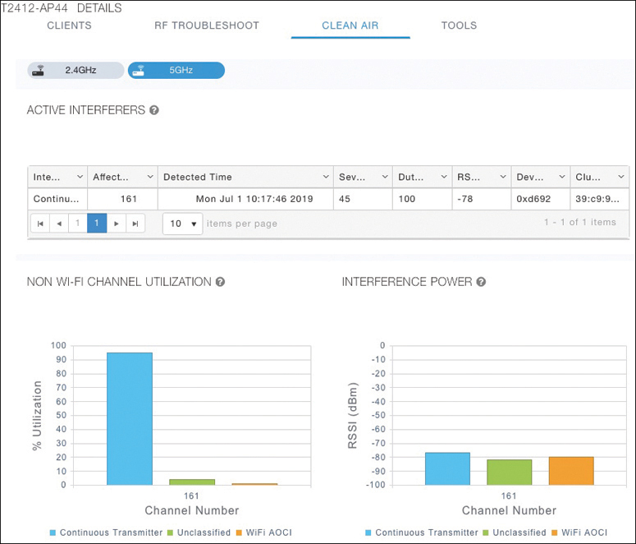
Troubleshooting Connectivity Problems at the AP Displaying Information About Clean Air
Select the Clean Air tab to see more details about the interfering devices that have been detected.
In Figure 21-17, the Active Interferers table lists one continuous transmitter device with a severity level of 45, a duty cycle of 100%, and an RSSI value of −78 dBm.
The severity level indicates how badly the interferer is affecting the channel. The duty cycle represents the percentage of time the device is actually transmitting.
Figure 21-17 Displaying Information

Slide 27
Troubleshooting Connectivity Problems at the AP Displaying Information About Clean Air (Cont.)
The two bar graphs represent the percentage of time the device is using the channel and the received signal strength level of the device.
If users are complaining about problems when they are around this AP, you should focus your efforts on tracking down the continuously transmitting device.
The best outcome is if the device can be disabled or moved to an unused channel. If not, you will likely have to reconfigure the AP to use a different channel to move away from the interference.
Figure 21-17 Displaying Information

Slide 28
Prepare for the Exam

Slide 29
Prepare for the Exam Key Topics for Chapter 21
Description
Conditions for Successful Wireless Association
WLC Client States
WLC Information About a Poorly Performing Client
Tools to Test Client Operation
Displaying Information About an AP
Interpreting Air Quality Values

